Slide 1
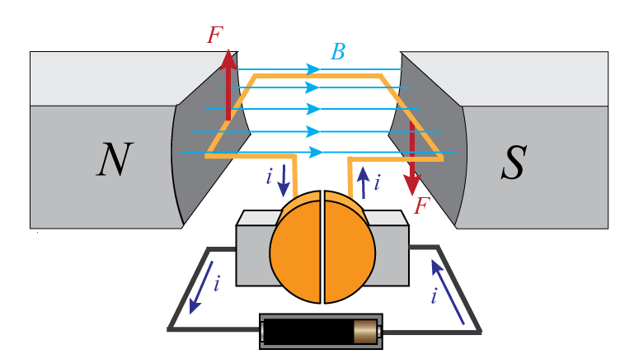
Lecture 10: DC Motors
Modeling of DC motors
Transmitting and converting motion (gear trains)

Slide 2
DC Motor
Armature-controlled DC motor model
Model resistance and inductance of the coil as lumped parameters
Same with mechanical inertia and friction
θ

Slide 3
DC Motor
Armature-controlled DC motor model
From Lorentz’s law
where K is the motor torque constant
From Faraday’s law
where K_{b} is the back emf constant
θ
Notes:
Variables different than in previous class

Slide 4
DC Motor
Armature-controlled DC motor model
Electrical domain:
Mechanical domain:
Two domains are
coupled by the previous relations
θ
Notes:
Often the contribution of the inductance is small compared to the contribution of the resistance

Slide 5
Example
Find the transfer function Θ(s)/E_{a}(s)
Notes:
Can look at from the perspective of different inputs, outputs (torque control, speed control)
Control often achieved with PWM

Slide 6
Example (continued)

Slide 7
DC Motor
In steady state
Slope is constant
Intercept changes with e_{a}
T
T_{stall}
torque
e_{a1}
e_{a2}
ω_{no-load}
ω
speed
Notes:
Slope is constant, intercept changes with applied voltage, gives some indication of how control can be achieved
In metric units K and Kb have the same units and are equal
In practice the maximum torque is limited, otherwise the currents would be extremely high and would damage the motor … though can operate above the rated limit for short amounts of time … won’t overheat if done only in short bursts

Slide 8
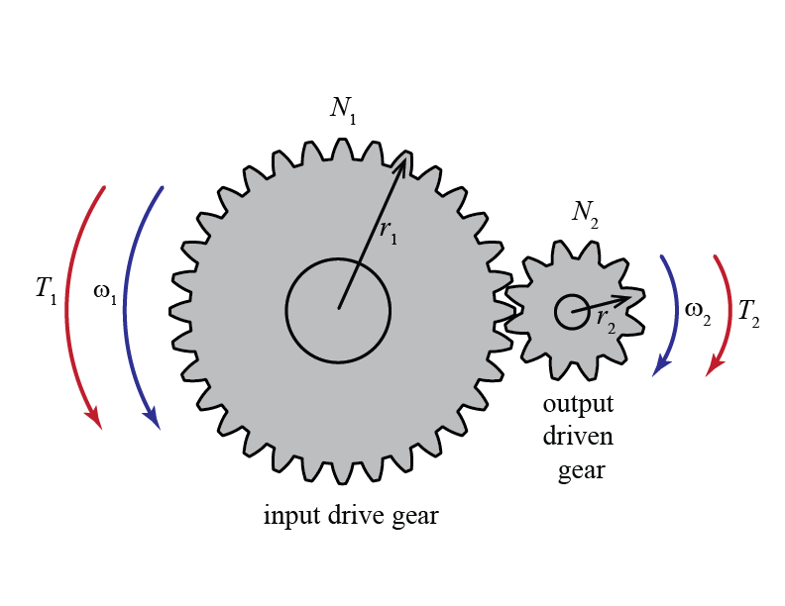
Transmitting and Converting Motion
Gears can be used to convert the speed and direction of motion, and modify the magnitude of transmitted torque
Notes:
Spur gear
Bevel gear
Rack and pinion

Slide 9
Simple Gear Train
Gears mesh without slipping, therefore,
and
Notes:
Kinematic relationship

Slide 10
Simple Gear Train
Furthermore, if friction losses are neglected, then the transmitted power is unchanged
which leads to
tradeoff between speed and torque

Slide 11
Complex Gear Train

Slide 12
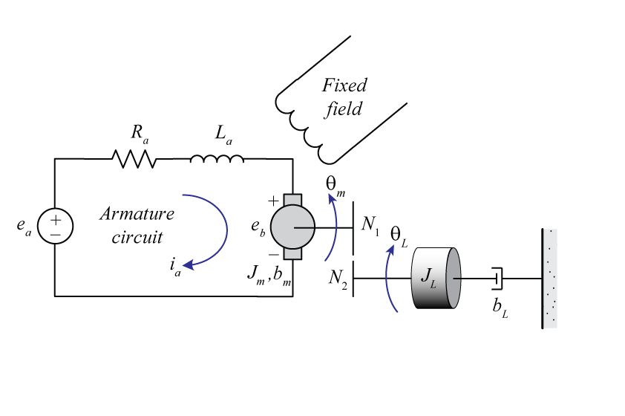
Example
Find the transfer function Θ_{L}(s)/E_{a}(s)
Notes:
Components are underneath
Make sure to include units

Slide 13
Example (continued)
Notes:
Components are underneath
Make sure to include units

Slide 14
Example (continued)
Notes:
Components are underneath
Make sure to include units

Slide 15
Lecture 11: Linearization
Introduction
Linearization of a nonlinear function
Linearization of a nonlinear diff equation

Slide 16
Nonlinear Systems
Most real world systems are nonlinear in some respect
Friction, air drag, saturation, backlash
Nonlinear differential equations are difficult, if not impossible, to solve analytically
Transfer functions model only linear systems
Previously in the course we have numerically simulated nonlinear systems to determine behavior … difficult to design in this manner, can lack insight

Slide 17
Nonlinear Systems
Nonlinear functions can approximated by a linear function in a neighborhood about an operating point
First two terms of a
Taylor series expansion

Slide 18

Linearization of a Function
Let’s look at this in another way
Recall the definition of a Taylor Series expansion
For small $Δ$x the H.O.T. ≈ 0
Higher order terms (H.O.T.)

Slide 19
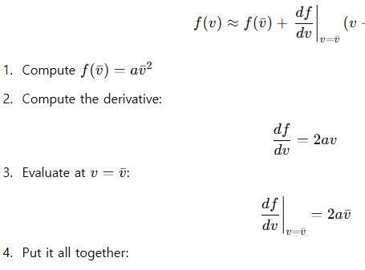
Example
_
Linearize f(v)=av² about v=v

Slide 20
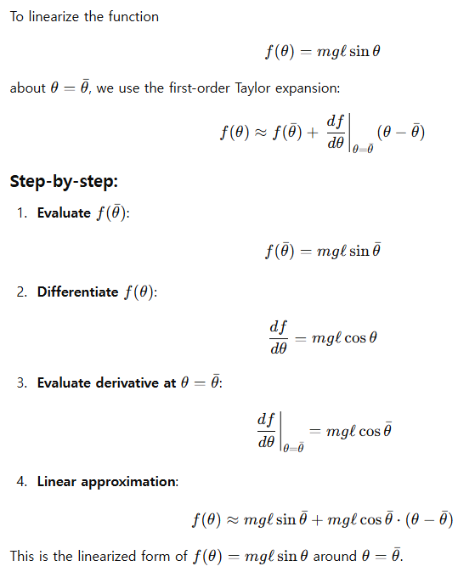
Example
_
Linearize f(θ)=mgl sin θ about θ = θ

Slide 21
Nonlinear Systems
This same idea can be used for providing approximate models of nonlinear systems
Nonlinear diff eq → Linear diff eq in terms of deviation from the operating point (Δ)
These approximate models are only valid in a small neighborhood about the operating point

Slide 22
Linearizing Differential Equations
First thing that must be done is to identify the operating point about which to linearize
Since the operating point is an equilibrium solution of the dynamic equation, the derivatives must equal zero
Therefore, if x=f(x,u), the equilibrium solution is found from 0=f(x,u) where x and u are constants
.
_
_
_
_

Slide 23
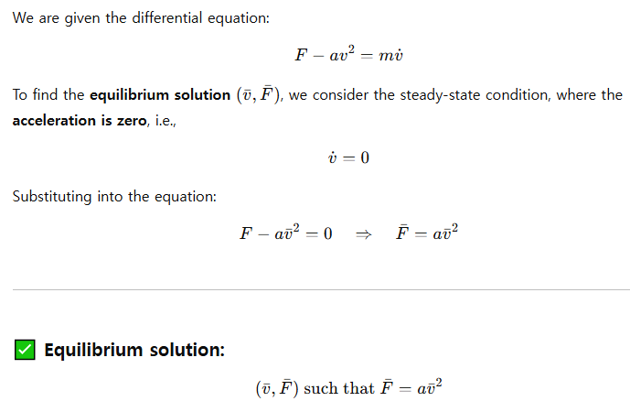
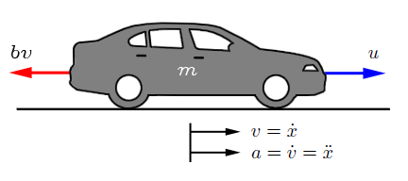
Example
_
_
.
Find the equilibrium solution (v, F) of F - av² = mv
f(v)
F

Slide 24
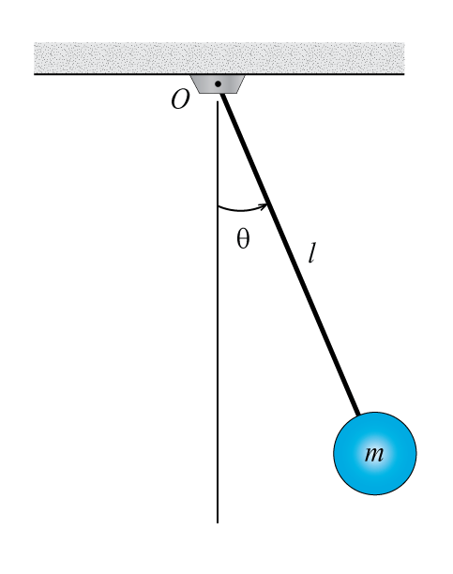
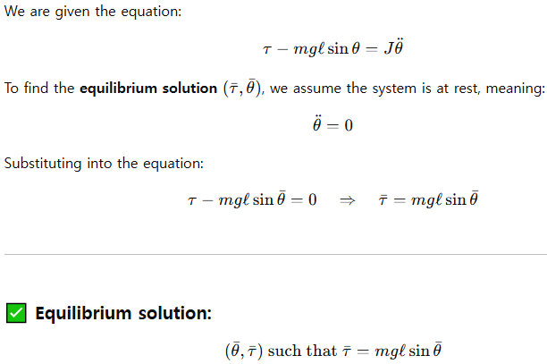
Example
_
..
_
Find the equilibrium solution (τ,θ) of τ - mgl sin θ =Jθ

Slide 25
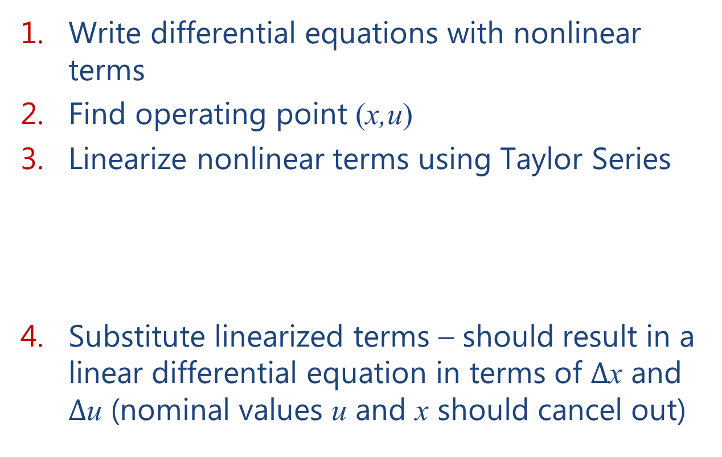
Overall Procedure
Write differential equations with nonlinear terms
Find operating point (x,u)
Linearize nonlinear terms using Taylor Series
Substitute linearized terms – should result in a linear differential equation in terms of $Δ$x and $Δ$u (nominal values u and x should cancel out)
_
_
_
_

Slide 26
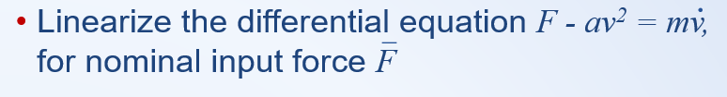
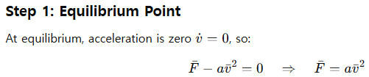
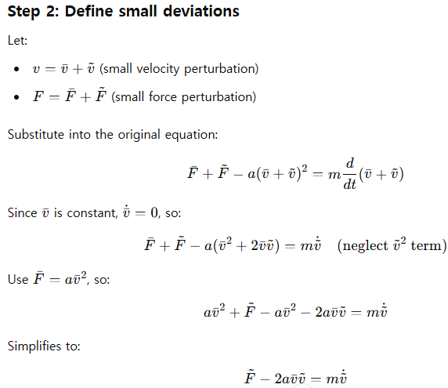
Example

Slide 27
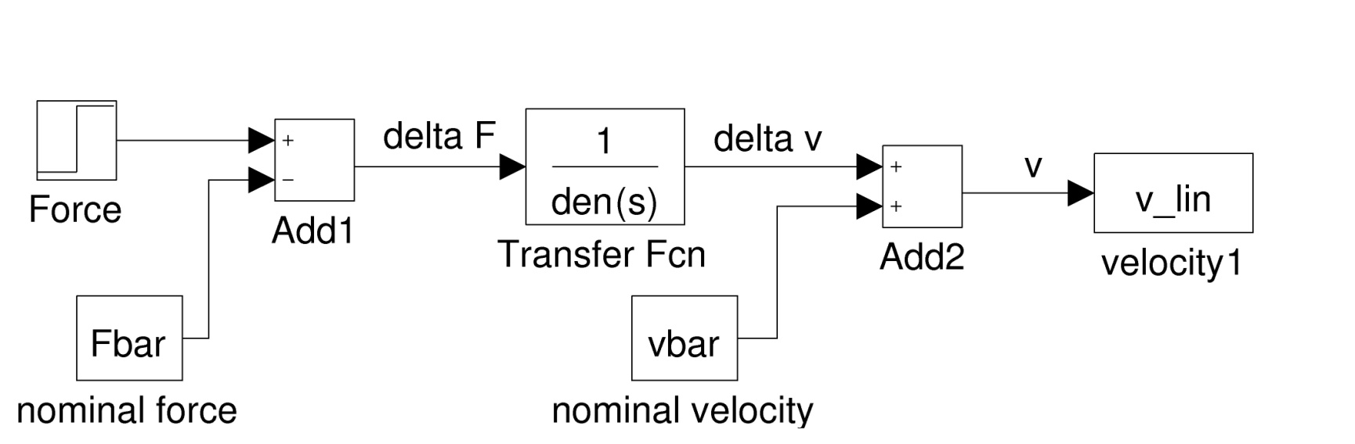
Example (continued)
Simulink model of linearized equation

Slide 28

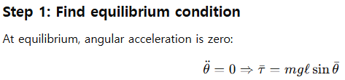
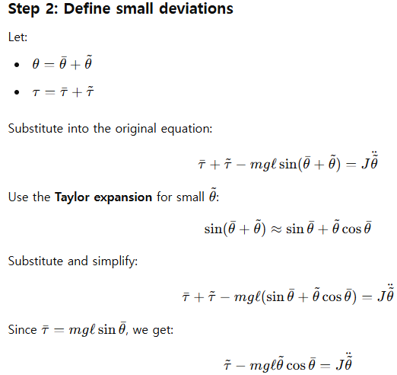
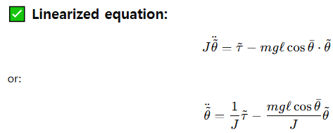
Example

Slide 29

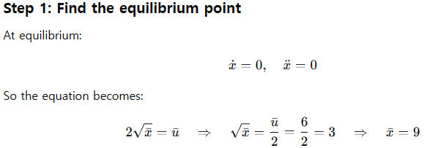
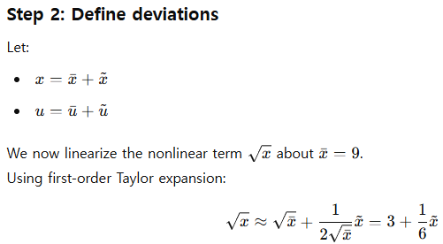
Example

Slide 30
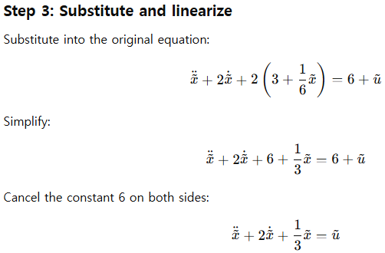
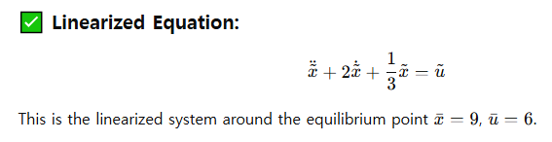
Example (continued)

Slide 31
Lecture 12: First-Order Systems
Time Response
Lecture 12:
Introduction to time response analysis
First-order systems
Stability
Lecture 13: Second-order systems
Lecture 14: Non-canonical systems

Slide 32
Time Response
During the semester we have found the time response of dynamic systems for arbitrary initial conditions and inputs
From diff eq and transfer function models
Classifying the response of some standard systems to standard inputs can provide insight
Ex Systems: first order, second order
Ex Inputs: impulse, step, ramp, sinusoid
Notes:
Many systems can be approximated well by first or second order systems (even if they are actually higher order)
Examples
an impulse is a shock test, like a car suspension going over a bump
a step is like a driver just slamming on the accelerator or brake
a ramp is a steady acceleration
Sinusoids of different frequencies can be used to understand the response of a system to complicated inputs made of lots of frequencies

Slide 33
Time Response
Characteristics of a standard response can be used for specifications (transient and steady state)
Response to simple inputs can be used for system identification, i.e. for finding a black-box model
SYSTEM
Notes:
Mentioned earlier, empirical derivation of models

Slide 34
First-Order Systems
Basic form:
Key parameters:
τ = time constant
k = DC gain
Many real systems have this basic form
Notes:
Called first order because the differential equation has only a first derivative and the transfer function has a single pole

Slide 35
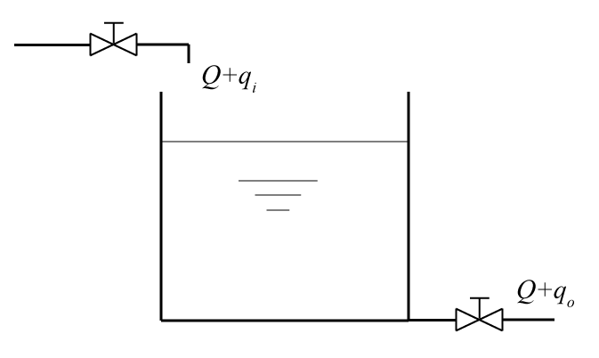
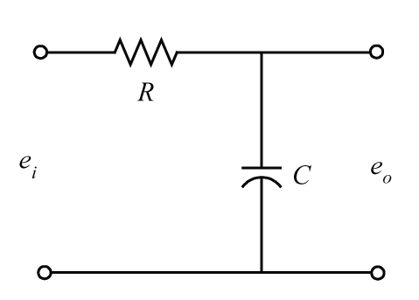
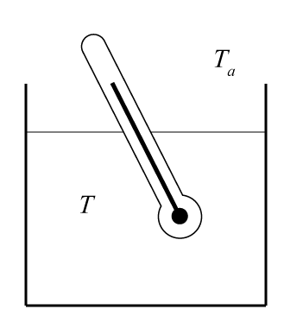
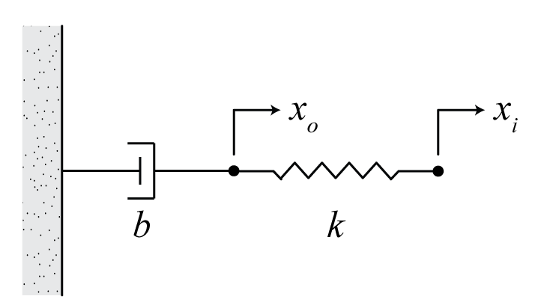
Notes:
Page 389 from Ogata … try to tie to automotive applications

Slide 36


First-Order Systems
Step response (u(t) = 1(t))
Notes:
Point out homogenous and particular solution, relation to poles

Slide 37
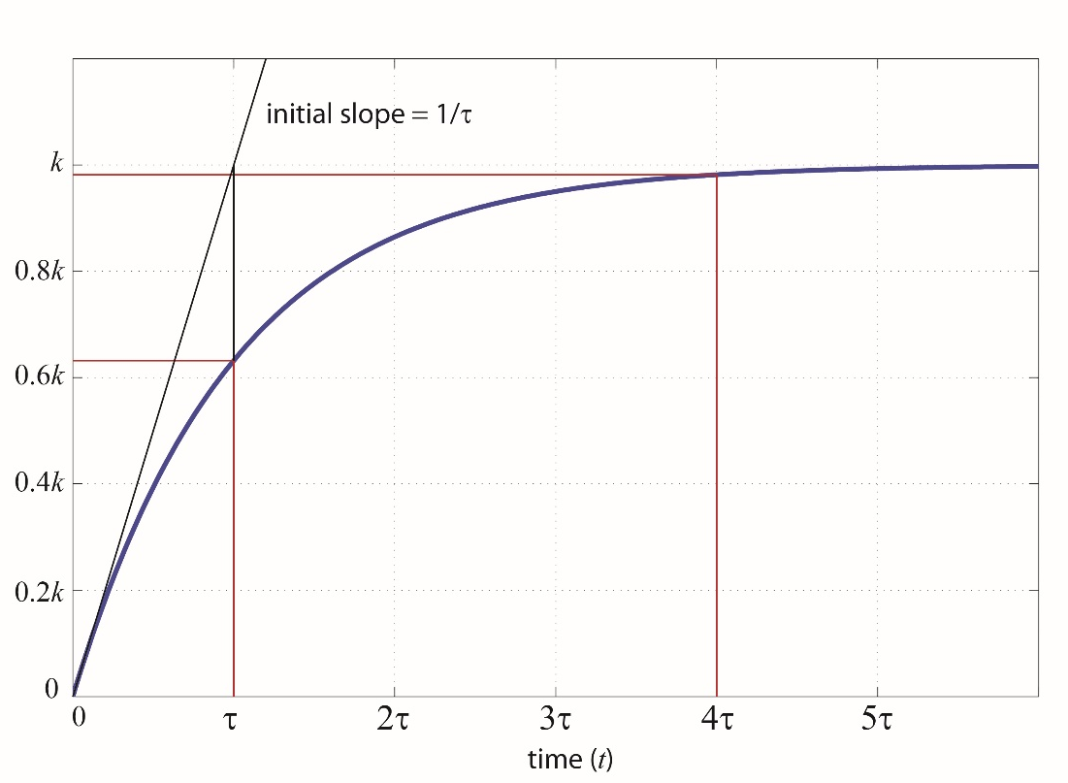
First-Order Systems
steady
state
transient
For t=τ
For t=4τ
within 2% of final value is
generally considered steady state(ss)
Notes:
initial value, t=0
Final value, t approaches infinity, can see why k is called steady state gain, DC gain … could also find using the initial value theorem or final value theorem
Steady state tends to be related to the forcing input

Slide 38
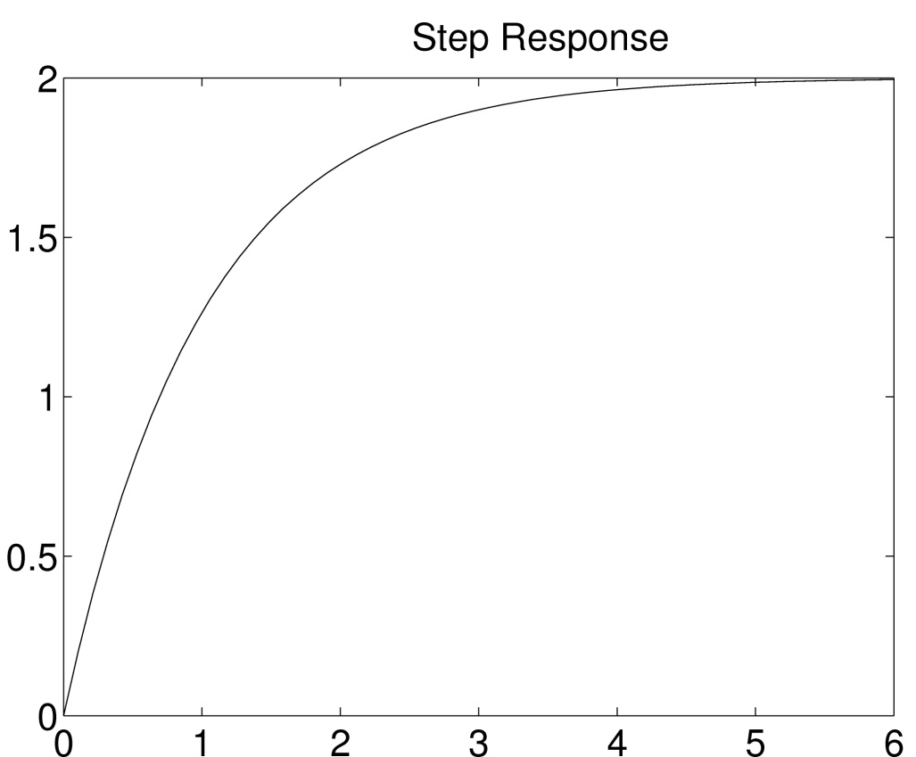
Example
Determine the TF of the system that produced
the following output in response to a unit step input

Slide 39
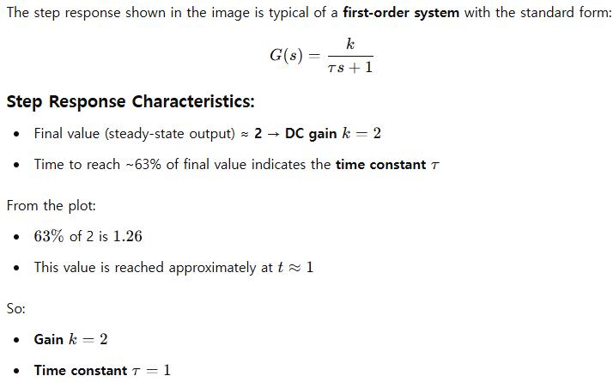


Slide 40
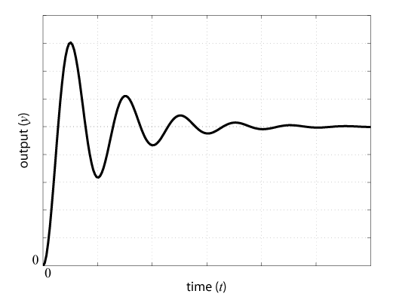
Second-Order Systems
Step response of 2nd-order system with complex poles

Slide 41
Stability
Note how the roots of the characteristic equation (poles of the transfer function) relate to natural response
Real part of pole = rate of decay (growth)
Imag part of pole = frequency of oscillation
If the response does not grow unbounded then it is stable (real part less than or equal to 0)
Notes:
What do we need to be true for a system’s response to be stable? If less than zero, if equal to zero

Slide 42
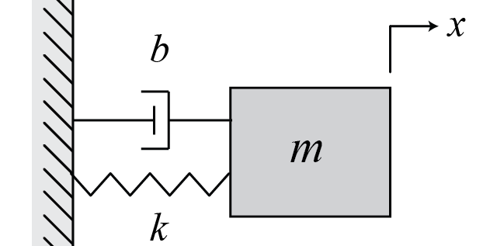
Stability
Asymptotic Stability: for no input and any initial condition, output x → 0 as t → ∞
example:
condition: all roots of the characteristic equation have negative real parts
if b = 0? stable, but not asymptotically stable!
Notes:
Car suspension example, driveline example … resonance!

Slide 43
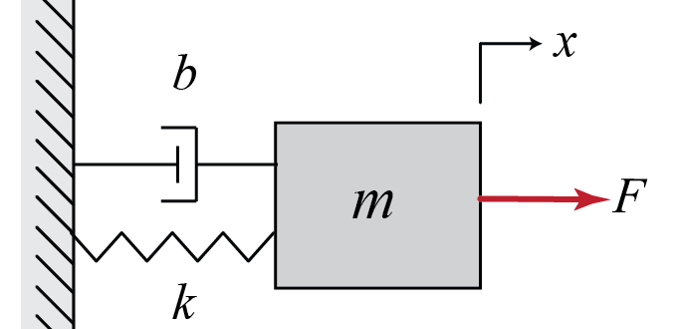
Stability
BIBO Stability: for zero initial conditions and bounded input, output x is bounded for all t
example:
condition: all poles of transfer function (roots of characteristic equation) have negative real part
if b = 0? stable, but not BIBO stable!
Notes:
Same requirement for linear systems

